Slide 1

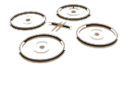

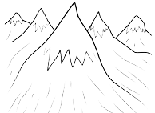
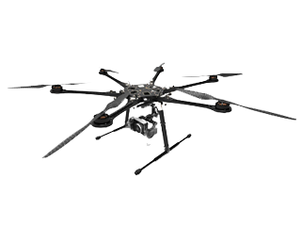

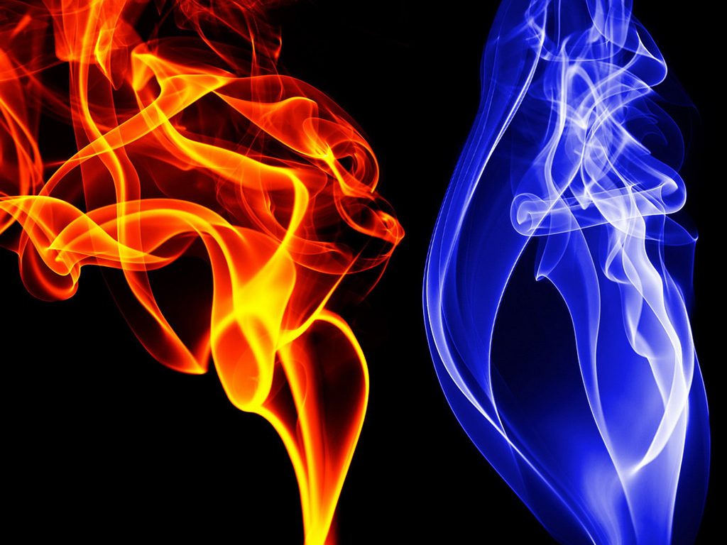
Development of Mapping and Navigation for
Autonomous Aerial Vehicle
Name : Ryan Seah Meng Yong
Admission No.: 103910D
Diploma : Aerospace Systems and Management
Project Supervisor: Mr. Goh Pit Kiam

Slide 2
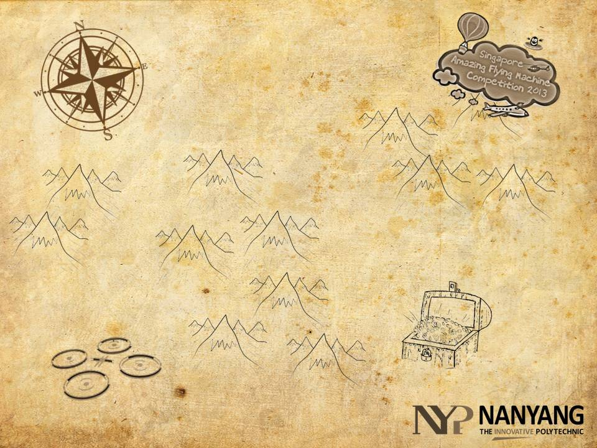

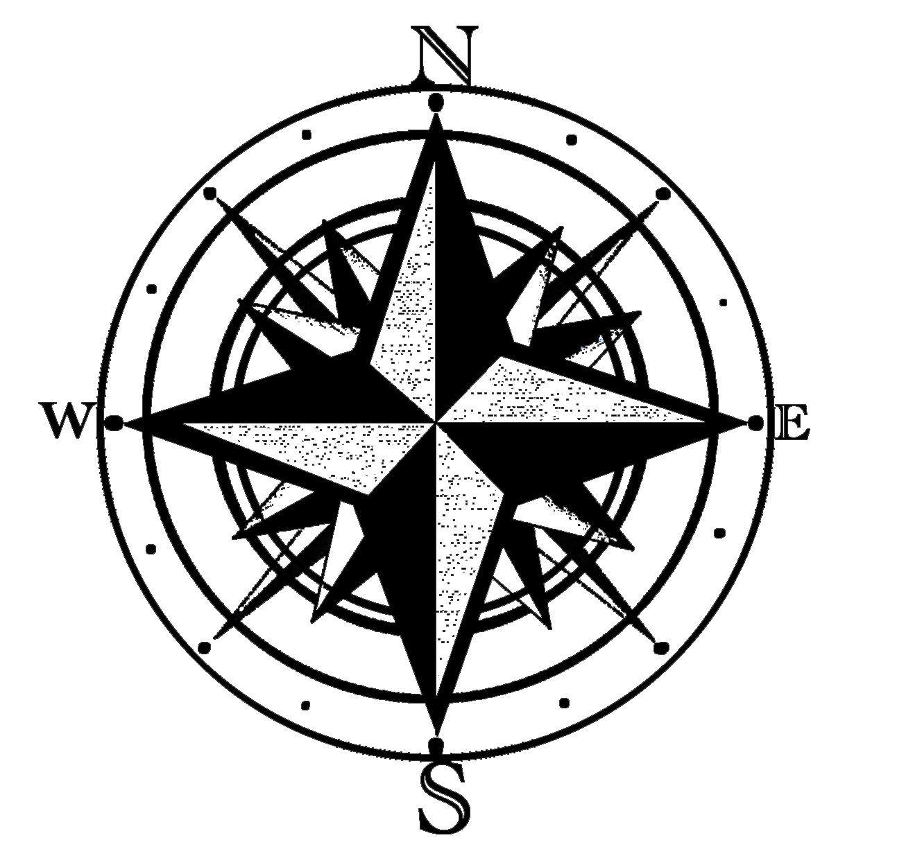
OVERVIEW
History
The Challenge
The Map
PID Tuning

Slide 3


HISTORY
In 2011, we navigated through course using a given color track
In 2012, we had to develop and navigate through the course using a 60 markers track

Slide 4
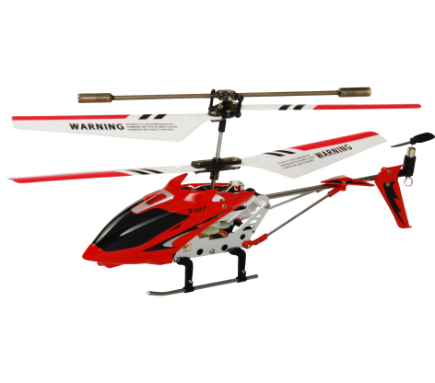
THE CHALLENGE
A limitation of 20 markers with the size of 20 cm (L) x 20 cm (W) x 5 cm (H).
A course that is 14 m (L) x 17 m (W).

Slide 5
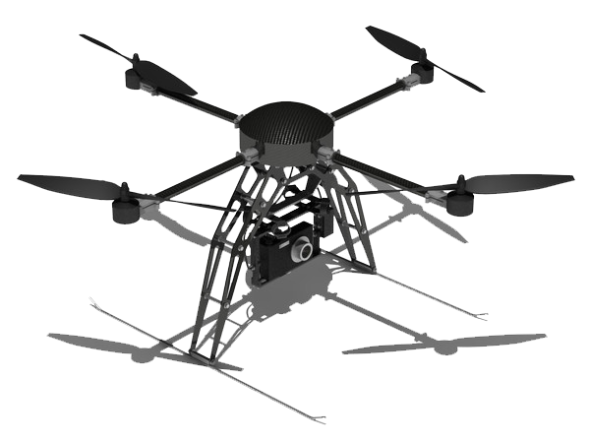
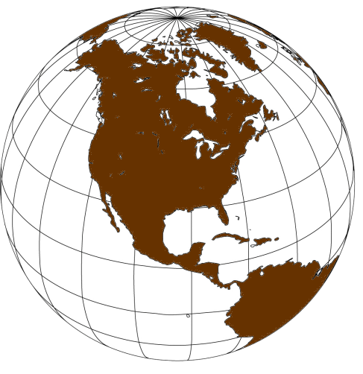
THE SOLUTION
We develop a scaled map .
Together with the use of Iterative Closest Point (ICP).
To calculate the accurate position and heading of the craft

Slide 6
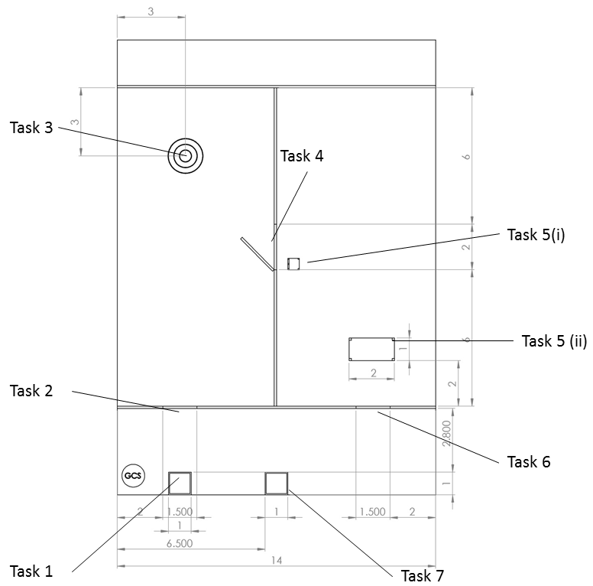
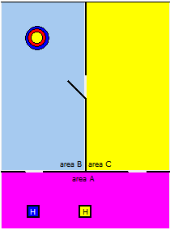

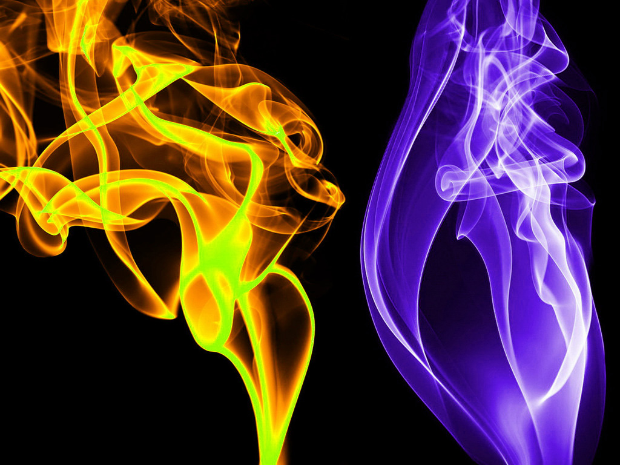
THE MAP
Actual
On Program
1 : 1
Internal representation

Slide 7
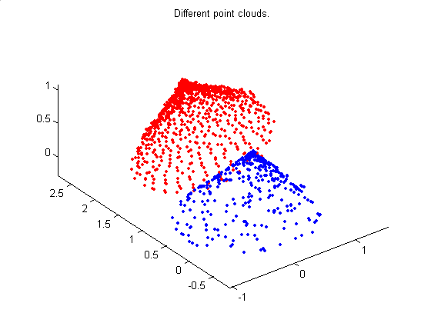
WHAT IS ICP?
It aligns a set of scanned 2D or 3D data with a set of known 2D or 3D data.
Rotate
Translate
Pre-Known Points
Scanned Points

Slide 8
THE ICP
It can be also use to locate the position and heading of the aircraft
Perceived position
Actual position
Pre-Known Points
Scanned Points

Slide 9
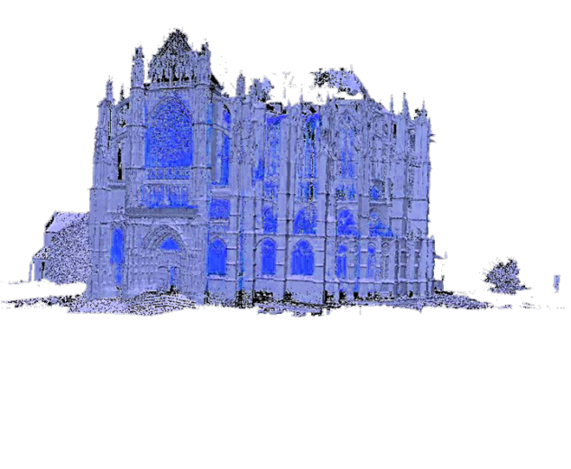
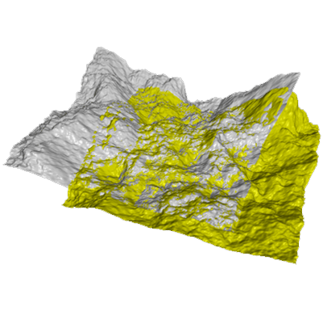
THE ICP
The rough gauge of the current position & heading of the aircraft.
A set of scanned point
A known set of pre-known points.
In return, it gives us a translation and rotation matrix
Position, Heading,
Pre-Known Points & Scan Points

Slide 10
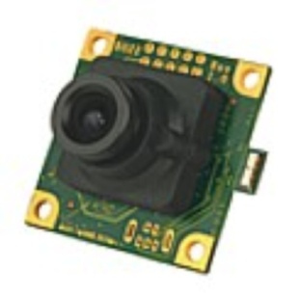
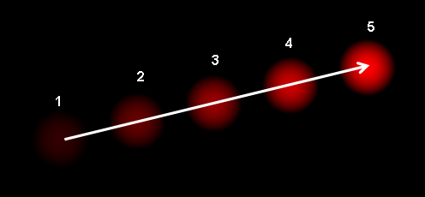
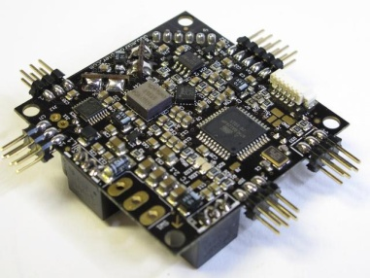
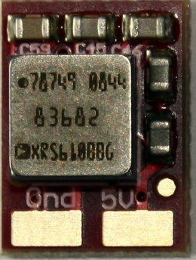
THE ICP
Position : Optical flow.
Heading : On board Gyro

Slide 11
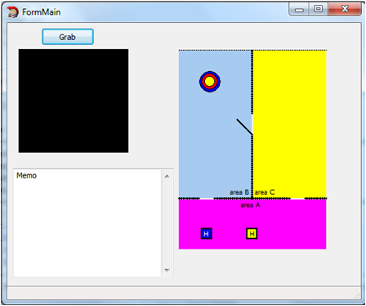
THE POINTS
Every 10 cm, 1 point

Slide 12
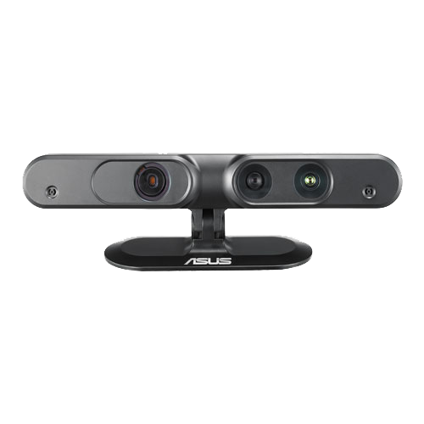
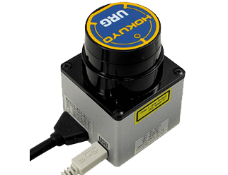


THE SCANNERS
Scanner
Number of points | 680 | 320
Range/m | 5 | 7

Slide 13
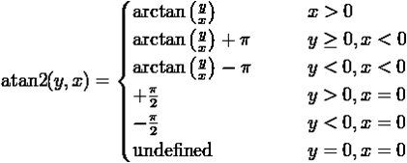
THE ROTATION
=
cos Ө
-sin Ө
R
sin Ө
cos Ө
Heading!

Slide 14
THE TRANSLATION
x
=
Translation ( x )
y
Position!

Slide 15
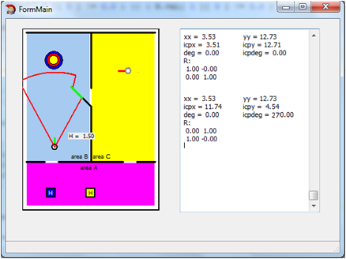
THE REFLECTION
xx = 3.53 yy = 12.73
icpx = 3.51 icpy = 12.71
deg = 0.00 icpdeg = 0.00
R:
1.00 -0.00
0.00 1.00
xx = 3.53 yy = 12.73
icpx = 11.74 icpy = 4.54
deg = 0.00 icpdeg = 90.00
R:
0.00 1.00
1.00 -0.00

Slide 16
THE REFLECTION
Reflect
Rotate
Translate
Pre-Known Points
Scanned Points

Slide 17
THE REFLECTION
A reflection matrix has a determinant of -1.
cos 2A
sin 2A
Reflection
=
sin 2A
-cos 2A

Slide 18
THE REFLECTION
cos 2A
sin 2A
=
cos Ө
-sin Ө
Ref.
=
Rot.
sin Ө
cos Ө
sin 2A
-cos 2A
Actual ICP Rotation = reflection x rotation
=
cos 2A
sin 2A
cos Ө
-sin Ө
R
sin Ө
cos Ө
sin 2A
-cos 2A

Slide 19
THE REFLECTION
=
cos 2A
sin 2A
cos Ө
sin Ө
R
sin 2A
-cos 2A
-sin Ө
cos Ө
=
cos 2A cos Ө - sin 2A sin Ө
cos 2A sin Ө + sin 2A cos Ө
sin 2A cos Ө + cos 2A sin Ө
sin 2A sin Ө - cos 2A cos Ө
=
cos( 2A + Ө)
sin( 2A + Ө)
sin( 2A + Ө)
-cos( 2A + Ө)
Clockwise Matrix

Slide 20
THE REFLECTION
=
cos 2A
sin 2A
cos Ө
-sin Ө
R
sin 2A
-cos 2A
sin Ө
cos Ө
=
cos 2A cos Ө + sin 2A sin Ө
-cos 2A sin Ө + sin 2A cos Ө
sin 2A cos Ө – cos 2A sin Ө
-sin 2A sin Ө – cos 2A cos Ө
=
cos( 2A - Ө)
sin( 2A - Ө)
sin( 2A - Ө)
-cos( 2A - Ө)
Anti-Clockwise Matrix

Slide 21
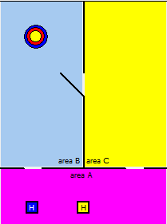
THE REFLECTION
=
cos( 2A + Ө)
sin( 2A + Ө)
cos( 2A - Ө)
sin( 2A - Ө)
R
OR
sin( 2A + Ө)
-cos( 2A + Ө)
sin( 2A - Ө)
-cos( 2A - Ө)
Since we know A is related to the points angle
Hence, A = 45ᵒ, 90ᵒ, 135ᵒ, 180ᵒ, 225ᵒ, 270ᵒ,315ᵒ and 360ᵒ
And u find the angle closest to the current angle.

Slide 22
THE REFLECTION
=
cos( 2A + Ө)
sin( 2A + Ө)
cos( 2A - Ө)
sin( 2A - Ө)
R
OR
sin( 2A + Ө)
-cos( 2A + Ө)
sin( 2A - Ө)
-cos( 2A - Ө)
To speed up the processing, I’ve used the comparison of values to determine whether to use the clockwise matrix or anti clockwise matrix:
2A – Ө < 2A
2A + Ө > 2A

Slide 23
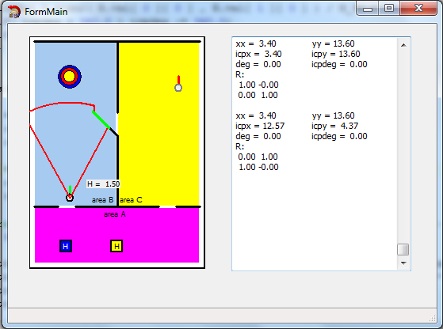
THE REFLECTION
xx = 3.40 yy = 13.60
icpx = 3.40 icpy = 13.60
deg = 0.00 icpdeg = 0.00
R:
1.00 -0.00
0.00 1.00
xx = 3.40 yy = 13.60
icpx = 12.57 icpy = 4.37
deg = 0.00 icpdeg = 0.00
R:
0.00 1.00
1.00 -0.00
Heading from reflection!

Slide 24
THE REFLECTION
Matched points = reflection x scanned points + translation
Since, Matched points = scanned points
P(x)
=
cos Ө
-sin Ө
x1
+
T(x)
P(y)
sin Ө
cos Ө
y1
T(y)
P(x)
=
a
b
x1
+
T’(x)
P(y)
c
d
y1
T’(y)

Slide 25
THE REFLECTION
T(x)
=
x1 ( a – cos Ө ) + y1 ( b + sin Ө ) + T’( x )
T(y)
x1 ( c + sin Ө ) + y1 ( d - cos Ө ) + T’( y )

Slide 26
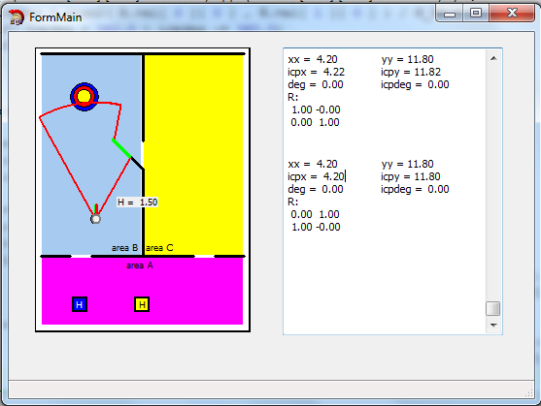
THE REFLECTION
xx = 4.20 yy = 11.80
icpx = 4.22 icpy = 11.82
deg = 0.00 icpdeg = 0.00
R:
1.00 -0.00
0.00 1.00
xx = 4.20 yy = 11.80
icpx = 4.20 icpy = 11.80
deg = 0.00 icpdeg = 0.00
R:
0.00 1.00
1.00 -0.00
Solved!

Slide 27
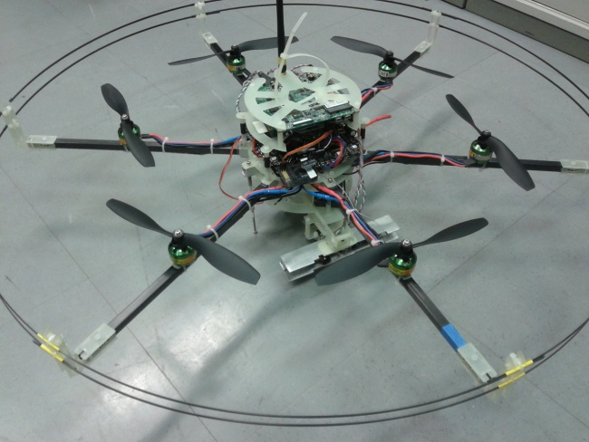
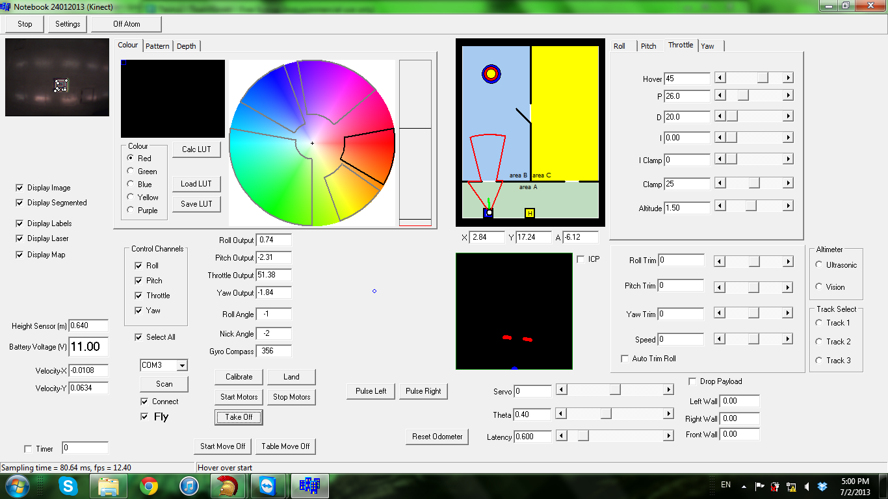
Main Program

Slide 28

THE END
THANK YOU VERY MUCH!
☺

